Slide 1
Alzheimer Disease Detection
Project Member Details:
ASUTOSH TRIPATHY
MANDELA SATISH
SUDHANSHU DAS
Project Guide:
Dr. T. RAJALAKSHMI
ASSOCIATE PROFESSOR, DEPT OF ECE, SRMIST

Slide 2
Index
Introduction 3-4
Motivation 5
Literature review 6-12
Problem Statement and Objectives 13-14
Design and Results 15-31
Software and Hardware Required 34-35
References 36

Slide 3
Introduction
Alzheimer’s disease (AD) is a progressive neurodegenerative disorder that leads to severe cognitive decline and memory loss, significantly affecting patients and their families.
Early detection is crucial for managing the disease effectively and slowing its progression.
AD progresses slowly in four stages: Mild Cognitive impairment, Mild Alzheimer’s, Moderate Alzheimer’s and Severe Alzheimer’s stages
Deep learning, a subset of artificial intelligence, offers a powerful approach for identifying AD by analyzing complex data such as MRI scans, genetic information, and clinical records.
By leveraging advanced neural networks, deep learning models can uncover subtle patterns indicative of early-stage Alzheimer’s with high accuracy.

Slide 4
Introduction
Stages of Alzheimer’s disease:
1. Mild Cognitive Impairment (MCI) : MCI is an intermediate stage between normal cognitive aging and dementia. It involves noticeable but not significant memory problems, such as forgetting names or appointments, that do not yet impact daily life
2. Mild Alzheimer's Disease : In this stage, memory loss and cognitive difficulties become more pronounced. Patients may still be able to function independently but will start to have more noticeable memory lapses.
3. Moderate Alzheimer’s :This is the longest stage and can last for several years. Cognitive decline and memory loss become more severe, impacting daily living and safety.
4. Severe Alzheimer's Disease : In the final stage, cognitive decline is profound. Patients lose the ability to respond to their environment, communicate, and control movement.

Slide 5
Motivation
Worldwide, 55 million people are believed to be living with Alzheimer's disease or other dementias as per International status. If breakthroughs are not discovered, rates could exceed 152 million by 2050.
The motivation behind this work is to enhance early detection of Alzheimer’s disease, which is crucial for timely intervention and better management of the condition.
Utilizing deep learning techniques can provide a more accurate and efficient analysis of complex medical data, potentially surpassing traditional diagnostic methods.

Slide 6
Literature Review
S.No | TITLE | AUTHOR | JOURNAL | INFERENCE
1. | A deep learning model for Alzheimer’s disease diagnosis based on patient clinical records | J.L. Ávila-Jiménez , Vanesa Cantón-Habas , María del Pilar Carrera-González, Manuel Rich-Ruiz , Sebastián Ventura | Computers in Biology and Medicine, Volume 169, February 2024 | In this paper the authors have proposed methods to develop an ANN tailored to analyze clinical data from patients diagnosed with dementia, with the primary goal of automating Alzheimer’s disease (AD) The proposed model demonstrates a competitive edge over K-Nearest Neighbors (KNN) and CART models with an accuracy of 79.5%

Slide 7
Literature Review
S.No | TITLE | AUTHOR | JOURNAL | INFERENCE
2. | Multi-modality MRI for Alzheimer’s disease detection using deep learning | Latifa Houria, Noureddine Belkhamsa, Assia Cherfa & Yazid Cherfa | Physical and Engineering Sciences in Medicine, 2022 | In this paper the authors proposed a computer-assisted diagnosis for Alzheimer’s disease classification using multimodality MRI imaging. The authors have used a new CNN to extract features from DTI-FA, DTI-MD, and GM images. Deep features are concatenated and fed to the SVM classifier The model achieved a classification accuracy of 99.79%, 99.85%, and 97.00% for AD/CN, AD/MCI, and CN/MCI, respectively.

Slide 8
Literature Review
S.No | TITLE | AUTHOR | JOURNAL | INFERENCE
3. | Alzheimer’s disease diagnosis and classification using deep learning techniques | Waleed Al Shehri | PeerJ Computer Science, 2022 | In this paper the author suggests a deep learning-based method for diagnosing and classifying Alzheimer’s disease utilizing the DenseNet-169 and ResNet-50 CNN architectures The DenseNet-169 architecture outperformed in the training and testing phases. The training and testing accuracy values for DenseNet-169 are 0.977 and 0.8382, while the accuracy values for ResNet-50 were 0.8870 and 0.8192.

Slide 9
Literature Review
S.No | TITLE | AUTHOR | JOURNAL | INFERENCE
4. | Deep Learning Approach for Early Detection of Alzheimer’s Disease | Hadeer A.Helaly, Mahmoud Badawy, Amira Y. Haikal | Cognitive computation, Volume 14, 2021 | In this paper the author has proposed E2AD2C framework for medical image classification and Alzheimer’s disease detection The VGG19 pre-trained model is fine-tuned and achieved an accuracy of 87% for multi-class AD stage classifications.

Slide 10
Literature Review
S.No | TITLE | AUTHOR | JOURNAL | INFERENCE
5. | Automated detection of Alzheimer's Disease using Deep Learning in MRI | P C Muhammed Raees and Vinu Thomas | Journal of Physics ,First International Conference on Advances in Smart Sensor, Signal Processing and Communication Technology (ICASSCT 2021), 19-20, March 2021, Goa, India | In this paper the authors have proposed a method to design an automated machine learning tool for the prediction of Alzheimer’s disease using a deep learning algorithm and they examined the performance levels of SVM and DNN models The model had an accuracy of 82% on AD prediction

Slide 11
Literature Review
S.No | TITLE | AUTHOR | JOURNAL | INFERENCE
6. | Alzheimer’s Disease Diagnosis using Deep Learning Techniques | Ahmad Waleed Salehi, Preety Baglat , Gaurav Gupta | International Journal of Engineering and Advanced Technology (IJEAT), February 2020 | In this paper the author has proposed a method to use the machine learning SVM techniques for classifying the AD patient from MRI with the use of two different data sets (OASIS and ADNI). The proposed method showed an accuracy of 86% for Alzheimer’s Disease prediction

Slide 12
Literature Review
S.No | TITLE | AUTHOR | JOURNAL | INFERENCE
7. | Early Diagnosis of Alzheimer's Disease Using Deep Learning | Huanhuan Ji, Zhenbing Liu, Wei Qi Yan, Reinhard Klette | ICCCV ‘19: Proceedings of the 2nd International Conference on Control and Computer Vision, 2019 | In this paper the method proposed by the authors was evaluated based on a dataset from the Alzheimer's Disease Neuroimaging Initiative for the early diagnosis of this illness. In particular, the accuracy rates of the classifications have reached up to 97.65% for AD/mild cognitive impairment and 88.37% for mild cognitive impairment/normal control.

Slide 13
Problem Statement
Alzheimer's disease affects millions globally, and early detection is vital for effective intervention and management.
It is very important to leverage techniques to improve the accuracy and efficiency of Alzheimer's detection, surpassing traditional diagnostic methods.
By enhancing early diagnosis, the approach must help to curb the growing prevalence of the disease.

Slide 14
Objectives
The aim of this project is to detect Alzheimer’s disease in its early stage, focusing on identifying subtle indicators and patterns that precede noticeable symptoms, thereby enabling timely intervention and treatment.
The objective is :
To develop and evaluate machine learning and deep learning models that can accurately identify early signs of Alzheimer’s disease from neuroimaging and other relevant datasets
To identify suitable model that could provide high accuracy thereby detects Alzheimer’s disease in early stages.

Slide 15
Design
Data Preprocessing: MRI images from different stages of Alzheimer's (Very Mild, Mild, Moderate) and Non-Demented cases are loaded and visualized to observe category differences. All images are resized to a uniform size (e.g., 128x128 pixels) to standardize inputs and reduce computational load. The resized 2D images are then flattened into 1D arrays for model training.
Feature Extraction: Principal Component Analysis (PCA) is applied to the flattened image data to reduce dimensionality. This step retains the most significant features, improving model efficiency and focusing on the most informative aspects of the images.

Slide 16
Design
Model Training: We trained out model using Support Vector Machine (SVM) algorithm using different kernels: a linear approximation with SGDClassifier, a polynomial kernel, and a Radial Basis Function (RBF) kernel. Each time the model is trained to classify images into Alzheimer's or Non-Demented/No Alzheimer’s categories.
Model Evaluation: The models are evaluated using metrics like Accuracy, Precision, Recall, F1 Score, and Confusion Matrix. Confusion matrices help visualize classification performance, while the Receiver Operating Characteristic (ROC) curve and Area Under the Curve (AUC) assess the model's overall effectiveness.

Slide 17
Design
Input Data
Data Preprocessing
Feature Extraction
Machine Learning Algorithms
Model Training
Deep learning techniques
Testing
Model Evaluation

Slide 18
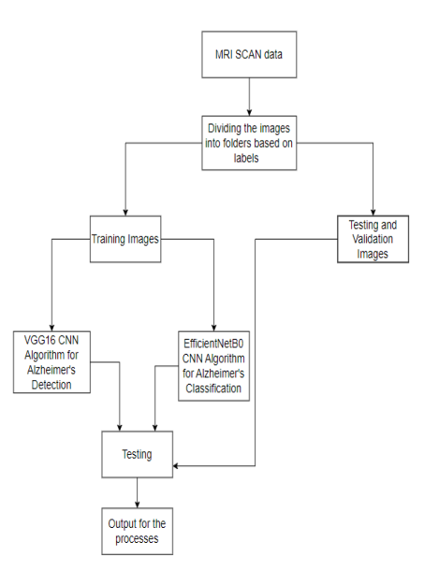
Design

Slide 19
Results
VGG16 CNN: The VGG16 model performed poorly in Alzheimer’s detection, achieving an accuracy of around 50%, barely better than random guessing. This low performance is likely due to converting grayscale MRI images to RGB, which may have introduced noise or caused a loss of important information. Since VGG16 is optimized for color images, this transformation negatively impacted its ability to effectively classify the images.

Slide 20
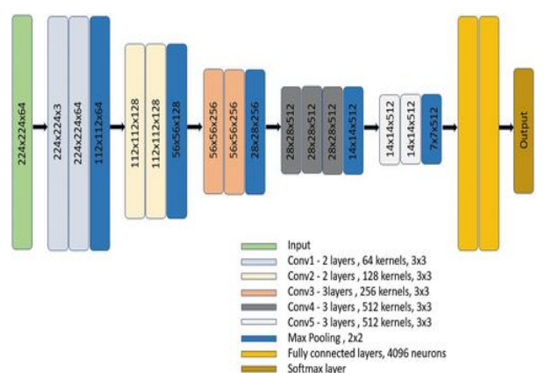
Results
VGG16 Architecture

Slide 21
Results
EfficientNetB0: The EfficientNetB0 model, when trained with a learning rate of 0.01, achieved an accuracy of 85.46% and a loss of 0.4405. Resizing the images to 128x128 led to a slightly lower accuracy of 83.52% with a loss of 0.745. The model's performance, evaluated through a confusion matrix, showed high accuracy in identifying true positives, making it effective for Alzheimer's disease diagnosis, with a relatively low number of false negatives, which is crucial in medical applications.

Slide 22
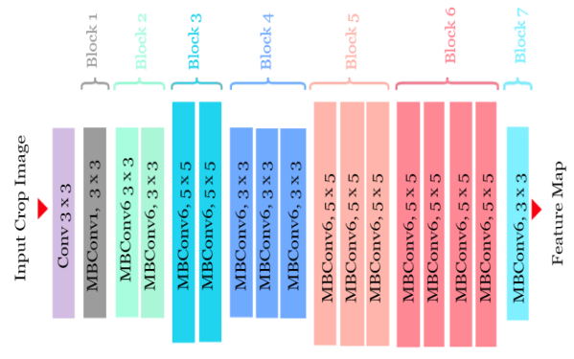
EffiecientNetB0 Architecture
Results

Slide 23
Results
Tiny CNN model:
Input Layer: Accepts small images (e.g., 32x32 or 64x64 pixels).
Conv Layer 1: Applies a few filters (e.g., 16 filters of 3x3) with ReLU activation.
MaxPooling Layer: Reduces spatial dimensions (e.g., 2x2 pooling).
Conv Layer 2: Adds more filters (e.g., 32 filters of 3x3) with ReLU and another pooling layer.
Fully Connected Layer: Flattens output and ends with a softmax or sigmoid layer for classification.

Slide 24
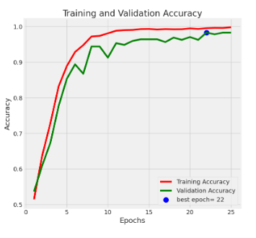
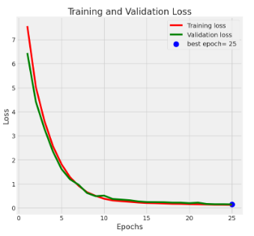
Results

Slide 25
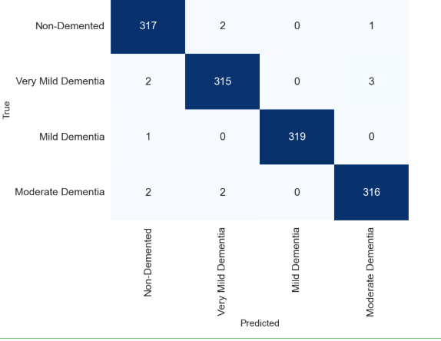
Results

Slide 26
Results
Proposed Method | Accuracy | Precision | Recall | F1-Score
Alzheimer’s Detection using CNN(VGG16) | 50% | 0.72 | 0.56 | 0.63
Alzheimer’s Disease Classification using CNN(EfficientNetB0)-LR0.1 | 50.7% | 0.78 | 0.60 | 0.68
Alzheimer’s Disease Classification using CNN(EfficientNetB0)-LR0.01 | 85% | 0.83 | 0.88 | 0.86
Alzheimer’s Disease Classification using CNN(EfficientNetB0)-Resize | 83% | 0.77 | 0.86 | 0.81
Tiny-CNN | 98.98% | 0.992 | 0.99 | 0.991

Slide 27
Conclusion
Overall analysis :
This study employed VGG16, EfficientNetB0, and TinyCNN architectures to classify MRI scans into four stages of Alzheimer’s disease.
A dataset of approximately 5,120 images was utilized for training and testing using PyTorch, Keras, and TensorFlow frameworks.
The models were evaluated using standard performance metrics and compared against existing approaches and parameter variations.
TinyCNN demonstrated superior performance, achieving an accuracy of 98.98%.
These results indicate that the proposed TinyCNN-based model offers a highly effective solution for Alzheimer’s classification.

Slide 28
Software required
Software-
Deep learning frameworks like TensorFlow and PyTorch, Programming language is Python
Data handling and processing tools like NumPy and Pandas for numerical and data manipulation in Python and OpenCV for computer vision tasks
IDE( Integrated Development Environments) for coding and managing projects
Matplotlib and Seaborn libraries and TensorBoard for creating plots and visualizations
GitHub for hosting repositories and collaboration

Slide 29
Hardware required
Hardware-
High performance hardware with robust CPU and at least 16GB RAM
Fast SSD storage is recommended for quick data access and handling large datasets effectively

Slide 30
Timeline

Slide 31
References
[1] Ávila-Jiménez, J. L., Cantón-Habas, V., del Pilar Carrera-González, M., Rich-Ruiz, M., & Ventura, S. (2024). A deep learning model for Alzheimer’s disease diagnosis based on patient clinical records. Computers in Biology and Medicine, 169, 107814.
[2] Houria, L., Belkhamsa, N., Cherfa, A., & Cherfa, Y. (2022). Multi-modality MRI for Alzheimer’s disease detection using deep learning. Physical and Engineering Sciences in Medicine, 45(4), 1043-1053.
[3] Al Shehri, W. (2022). Alzheimer’s disease diagnosis and classification using deep learning techniques. PeerJ Computer Science, 8, e1177.
[4] Helaly, H. A., Badawy, M., & Haikal, A. Y. (2022). Deep learning approach for early detection of Alzheimer’s disease. Cognitive computation, 14(5), 1711-1727.
[5] Raees, P. M., & Thomas, V. (2021, May). Automated detection of Alzheimer’s Disease using Deep Learning in MRI. In Journal of Physics: Conference Series (Vol. 1921, No. 1, p. 012024). IOP Publishing.
[6] Salehi, A. W., Baglat, P., & Gupta, G. (2020). Alzheimer’s disease diagnosis using deep learning techniques. Int. J. Eng. Adv. Technol, 9(3), 874-880.
[7] Liu, S., Liu, S., Cai, W., Pujol, S., Kikinis, R., & Feng, D. (2014, April). Early diagnosis of Alzheimer's disease with deep learning. In 2014 IEEE 11th international symposium on biomedical imaging (ISBI) (pp. 1015-1018). IEEE.

